Slide 1


Philippines Delivery Center Development Control Services
Hands on:
Creating a New Project
POM – Program Object Model
POM Quick Overview
Building the New Project
Reusing Builds
Building a Project Site
Development Operations Bootcamp
MAVEN

Slide 2

PLAN
ANALYZE
TEST
DEPLOY
OPERATE
DESIGN
BUILD/
IMPLEMENT
SHELF/UPDATE
SDLC
SYSTEMS
DEVELOPMENT
LIFE
CYCLE

Slide 3

AGENDA
{
Creating a New Project
POM – Program Object Model
POM Quick Overview
Building the New Project
Reusing Builds
Building a Project Site
Overview
Benefits of using Maven
Configuration
Hands on

Slide 4



MAVEN OVERVIEW
Maven is generally considered by many to be a build tool.
PROJECT MANAGEMENT TOOL
source code
standalone form
MAVEN DEVOPS BOOTCAMP \ MAVEN OVERVIEW
Notes:
BUILD - the process by which source code is converted into a stand-alone form that can be run on a computer or to the form itself. One of the most important steps of a software build is the compilation process, where source code files are converted into executable code.

Slide 5
MAVEN OVERVIEW
Maven is about the application of patterns in order to achieve an infrastructure which displays the characteristics of visibility, reusability, maintainability, and comprehensibility.
MAVEN DEVOPS BOOTCAMP \ MAVEN OVERVIEW

Slide 6
Without visibility, it is unlikely an individual will know what another has accomplished
and as such there is a very good chance useful code will not be reused.
When code is not reused, it is very hard to create a maintainable system.
MAVEN OVERVIEW
Maven is generally considered by many to be a build tool.
Maven is about the application of patterns in order to achieve an infrastructure which displays the characteristics of visibility, reusability, maintainability, and comprehensibility.
MAVEN DEVOPS BOOTCAMP \ MAVEN OVERVIEW
Notes:
BUILD - the process by which source code is converted into a stand-alone form that can be run on a computer or to the form itself. One of the most important steps of a software build is the compilation process, where source code files are converted into executable code.

Slide 7







MAVEN OVERVIEW
It provides a way to help with managing:
builds
documentation
reporting
dependencies
software configuration management (SCM)
releases
distribution
MAVEN DEVOPS BOOTCAMP \ BENEFITS OF USING MAVEN
Notes:
BUILD - the process by which source code is converted into a stand-alone form that can be run on a computer or to the form itself. One of the most important steps of a software build is the compilation process, where source code files are converted into executable code.

Slide 8
MAVEN OVERVIEW
It provides a way to help with managing:
Software dependencies are used to identify relationships between pieces of software. Dependency information is defined as requirements and capabilities.
builds
documentation
reporting
dependencies
The task of tracking and controlling changes in the software
software configuration management (SCM)
releases
distribution
MAVEN DEVOPS BOOTCAMP \ BENEFITS OF USING MAVEN
Notes:
BUILD - the process by which source code is converted into a stand-alone form that can be run on a computer or to the form itself. One of the most important steps of a software build is the compilation process, where source code files are converted into executable code.

Slide 9

BENEFITS OF USING MAVEN
Works well with distributed teams. Location doesn't matter.
MAVEN DEVOPS BOOTCAMP \ BENEFITS OF USING MAVEN
Notes:
BUILD - the process by which source code is converted into a stand-alone form that can be run on a computer or to the form itself. One of the most important steps of a software build is the compilation process, where source code files are converted into executable code.

Slide 10
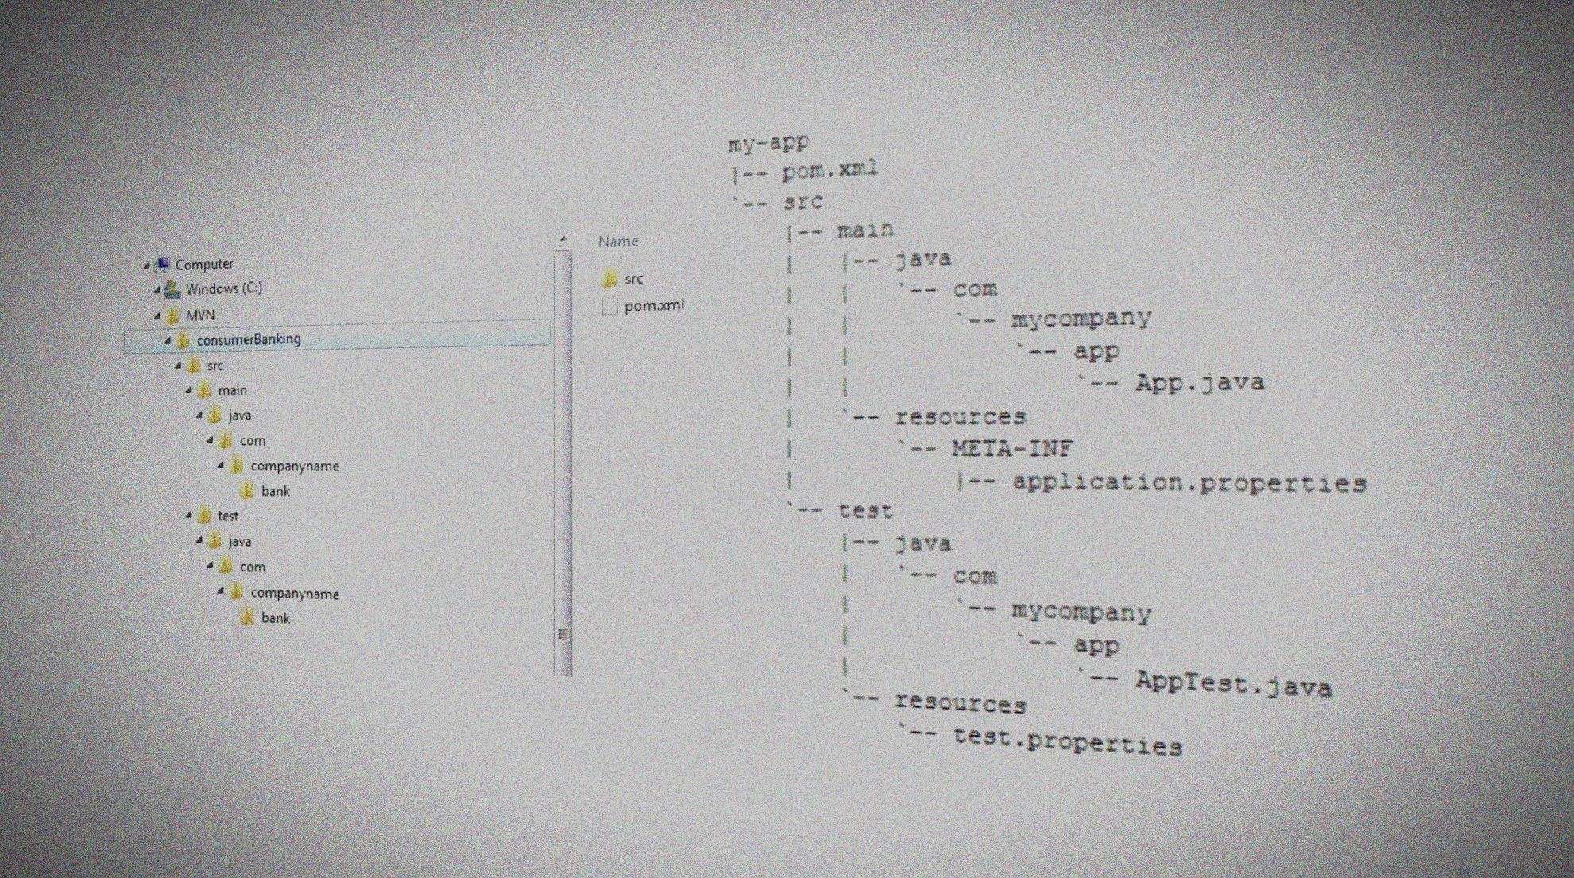
BENEFITS OF USING MAVEN
One directory layout or common build structure
MAVEN DEVOPS BOOTCAMP \ BENEFITS OF USING MAVEN
Notes:
BUILD - the process by which source code is converted into a stand-alone form that can be run on a computer or to the form itself. One of the most important steps of a software build is the compilation process, where source code files are converted into executable code.

Slide 11
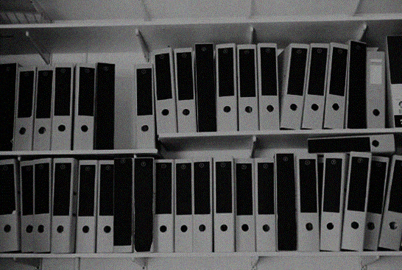
BENEFITS OF USING MAVEN
All artifacts are versioned and stored in a repository
MAVEN DEVOPS BOOTCAMP \ BENEFITS OF USING MAVEN
Notes:
BUILD - the process by which source code is converted into a stand-alone form that can be run on a computer or to the form itself. One of the most important steps of a software build is the compilation process, where source code files are converted into executable code.

Slide 12

BENEFITS OF USING MAVEN
Build process is standardized for all projects. – convention vrs configuration.
MAVEN DEVOPS BOOTCAMP \ BENEFITS OF USING MAVEN
Notes:
BUILD - the process by which source code is converted into a stand-alone form that can be run on a computer or to the form itself. One of the most important steps of a software build is the compilation process, where source code files are converted into executable code.

Slide 13

BENEFITS OF USING MAVEN
Getting a number of reports and metrics for a project "for free“.
MAVEN DEVOPS BOOTCAMP \ BENEFITS OF USING MAVEN
Notes:
BUILD - the process by which source code is converted into a stand-alone form that can be run on a computer or to the form itself. One of the most important steps of a software build is the compilation process, where source code files are converted into executable code.

Slide 14

BENEFITS OF USING MAVEN
Setting up a project is really fast.
MAVEN DEVOPS BOOTCAMP \ CONFIGURING MAVEN
Notes:
BUILD - the process by which source code is converted into a stand-alone form that can be run on a computer or to the form itself. One of the most important steps of a software build is the compilation process, where source code files are converted into executable code.

Slide 15
CONFIGURING MAVEN
Maven configuration occurs at 3 levels:
Project - most static configuration occurs in pom.xml
Installation - this is configuration added once for a Maven installation
User - this is configuration specific to a particular user
MAVEN DEVOPS BOOTCAMP \ SYSTEM REQUIREMENTS
Notes:
BUILD - the process by which source code is converted into a stand-alone form that can be run on a computer or to the form itself. One of the most important steps of a software build is the compilation process, where source code files are converted into executable code.

Slide 16
CONFIGURING MAVEN
SYSTEM REQUIREMENTS
Maven configuration occurs at 3 levels:
Project - most static configuration occurs in pom.xml
Installation - this is configuration added once for a Maven installation
User - this is configuration specific to a particular user
JDK | 1.5 or above (this is to execute Maven - it still allows you to build against 1.3 and prior JDK's)
Memory | No minimum requirement.
Disk | No minimum requirement. Approximately 100MB will be used for your local repository, however this will vary depending on usage and can be removed and redownloaded at any time.
Operating System | No minimum requirement. On Windows, Windows NT and above or Cygwin is required for the startup scripts. Tested on Windows XP, Fedora Core and Mac OS X
MAVEN DEVOPS BOOTCAMP \ MAVEN OVERVIEW
MAVEN DEVOPS BOOTCAMP \ INSTALLATION
Notes:
BUILD - the process by which source code is converted into a stand-alone form that can be run on a computer or to the form itself. One of the most important steps of a software build is the compilation process, where source code files are converted into executable code.

Slide 17
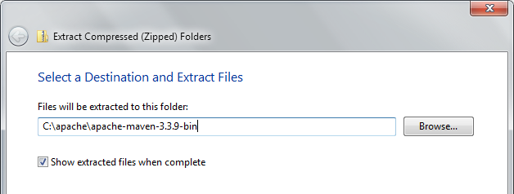
INSTALLATION ON WIN XP/2000
Unzip the distribution archive, i.e. apache-maven-3.0.3-bin.zip to the directory you wish to install Maven 3.0.3. These instructions assume you chose C:\Program Files\Apache Software Foundation. The subdirectory apache-maven-3.0.3 will be created from the archive.
MAVEN DEVOPS BOOTCAMP \ INSTALLATION
Notes:
BUILD - the process by which source code is converted into a stand-alone form that can be run on a computer or to the form itself. One of the most important steps of a software build is the compilation process, where source code files are converted into executable code.

Slide 18
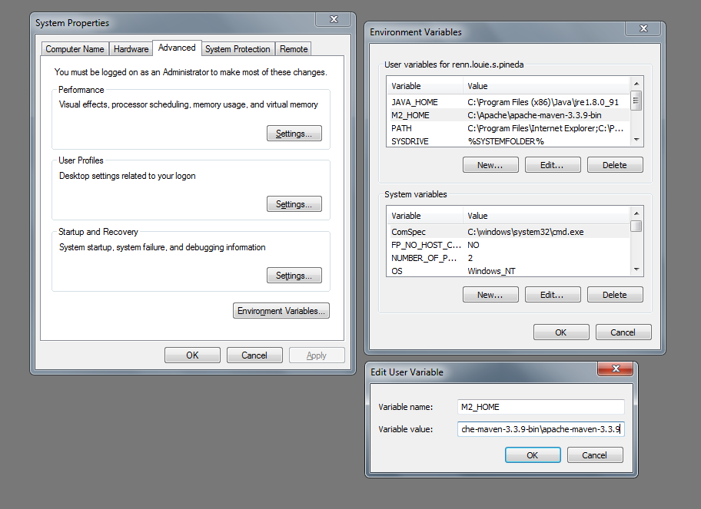
INSTALLATION ON WIN XP/2000
2
Add the M2_HOME environment variable by opening up the system properties (WinKey + Pause), selecting the "Advanced" tab, and the "Environment Variables" button, then adding the M2_HOME variable in the user variables with the value C:\Program Files\Apache Software Foundation\apache-maven-3.3.9-bin. Be sure to omit any quotation marks around the path even if it contains spaces.
Note: For Maven < 2.0.9, also be sure that the M2_HOME doesn't have a '\' as last character.
1
3
MAVEN DEVOPS BOOTCAMP \ INSTALLATION
Notes:
BUILD - the process by which source code is converted into a stand-alone form that can be run on a computer or to the form itself. One of the most important steps of a software build is the compilation process, where source code files are converted into executable code.

Slide 19
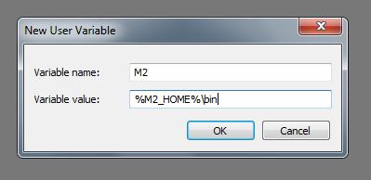
INSTALLATION ON WIN XP/2000
In the same dialog, add the M2 environment variable in the user variables with the value %M2_HOME%\bin.
MAVEN DEVOPS BOOTCAMP \ INSTALLATION
Notes:
BUILD - the process by which source code is converted into a stand-alone form that can be run on a computer or to the form itself. One of the most important steps of a software build is the compilation process, where source code files are converted into executable code.

Slide 20
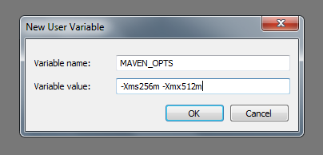
INSTALLATION ON WIN XP/2000
Optional: In the same dialog, add the MAVEN_OPTS environment variable in the user variables to specify JVM properties, e.g. the value -Xms256m -Xmx512m.
This environment variable can be used to supply extra options to Maven.
MAVEN DEVOPS BOOTCAMP \ INSTALLATION
Notes:
BUILD - the process by which source code is converted into a stand-alone form that can be run on a computer or to the form itself. One of the most important steps of a software build is the compilation process, where source code files are converted into executable code.

Slide 21
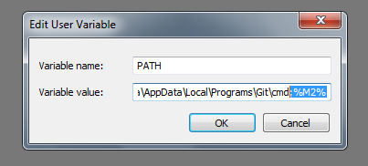
INSTALLATION ON WIN XP/2000
In the same dialog, update/create the Path environment variable in the user variables and prepend the value %M2% to add Maven available in the command line.
MAVEN DEVOPS BOOTCAMP \ INSTALLATION
Notes:
BUILD - the process by which source code is converted into a stand-alone form that can be run on a computer or to the form itself. One of the most important steps of a software build is the compilation process, where source code files are converted into executable code.

Slide 22
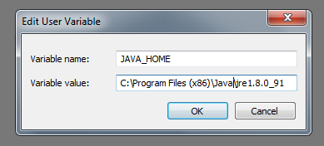
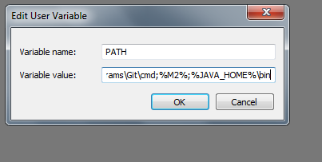
INSTALLATION ON WIN XP/2000
In the same dialog, make sure that JAVA_HOME exists in your user variables or in the system variables and it is set to the location of your JDK, e.g. C:\Program Files\Java\jdk1.5.0_02 and that %JAVA_HOME%\bin is in your Path environment variable.
MAVEN DEVOPS BOOTCAMP \ INSTALLATION
Notes:
BUILD - the process by which source code is converted into a stand-alone form that can be run on a computer or to the form itself. One of the most important steps of a software build is the compilation process, where source code files are converted into executable code.

Slide 23
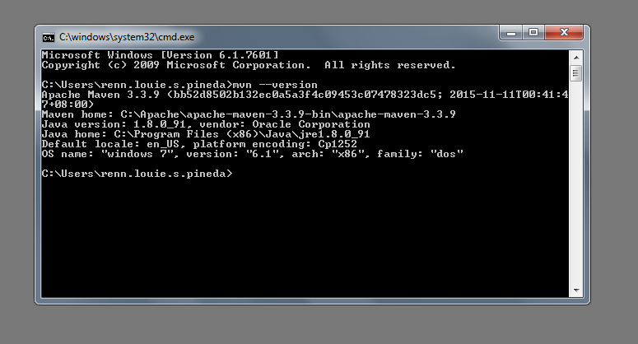
INSTALLATION ON WIN XP/2000
Open a new command prompt (Winkey + R then type cmd) and run mvn --version to verify that it is correctly installed.
MAVEN DEVOPS BOOTCAMP \ PLUGINS
Notes:
BUILD - the process by which source code is converted into a stand-alone form that can be run on a computer or to the form itself. One of the most important steps of a software build is the compilation process, where source code files are converted into executable code.

Slide 24
MAVEN – PLUGINS CONTAIN GOALS
Mavin is—at its heart—a plugin execution framework. That is, all work is done by plugins.
Plugins have goals.
GOAL
GOAL
GOAL
PLUGIN
MAVEN DEVOPS BOOTCAMP \ PLUGINS
Notes:
BUILD - the process by which source code is converted into a stand-alone form that can be run on a computer or to the form itself. One of the most important steps of a software build is the compilation process, where source code files are converted into executable code.

Slide 25
MAVEN – PLUGINS CONTAIN GOALS
Mavin is—at its heart—a plugin execution framework. That is, all work is done by plugins.
Plugins have goals.
Maven has plugins for everything
from compiling Java code, to generating reports, to deploying to an application server.
GOAL
GOAL
GOAL
PLUGIN
MAVEN DEVOPS BOOTCAMP \ PLUGINS
Notes:
BUILD - the process by which source code is converted into a stand-alone form that can be run on a computer or to the form itself. One of the most important steps of a software build is the compilation process, where source code files are converted into executable code.

Slide 26
MAVEN PLUGINS
Complete list of Maven Plugins: http://maven.apache.org/plugins/index.html
Plugin | Type* | Version | Release Date | Description | Source Repository | Issue Tracking
Core plugins |  |  |  | Plugins corresponding to default core phases (i.e. clean, compile). They may have multiple goals as well.
clean | B | 2.4.1 | 5/12/2010 | Clean up after the build. | SVN | JIRA
compiler | B | 2.3.2 | 9/9/2010 | Compiles Java sources. | SVN | JIRA
deploy | B | 2.7 | 8/24/2011 | Deploy the built artifact to the remote repository. | SVN | JIRA
failsafe | B | 2.9 | 6/18/2011 | Run the JUnit integration tests in an isolated classloader. | SVN | JIRA
install | B | 2.3.1 | 5/21/2010 | Install the built artifact into the local repository. | SVN | JIRA
resources | B | 2.5 | 2/27/2011 | Copy the resources to the output directory for including in the JAR. | SVN | JIRA
site for Maven 2 | B | 2.3 | 5/23/2011 | Generate a site for the current project. | SVN | JIRA
site for Maven 2 & 3 | B | 3 | 8/2/2011 | Generate a site for the current project. | SVN | JIRA
surefire | B | 2.9 | 6/18/2011 | Run the JUnit unit tests in an isolated classloader. | SVN | JIRA
verifier | B | 1 | 1/30/2010 | Useful for integration tests - verifies the existence of certain conditions. | SVN | JIRA
Packaging types / tools |  |  |  | These plugins relate to packaging respective artifact types. | SVN | JIRA
ear | B | 2.6 | 6/16/2011 | Generate an EAR from the current project. | SVN | JIRA
ejb | B | 2.3 | 9/18/2010 | Build an EJB (and optional client) from the current project. | SVN | JIRA
jar | B | 2.3.2 | 8/21/2011 | Build a JAR from the current project. | SVN | JIRA
rar | B | 2.2 | 2/28/2007 | Build a RAR from the current project. | SVN | JIRA
MAVEN DEVOPS BOOTCAMP \ CREATING A NEW PROJECT FROM AN ARCHETYPE
Notes:
BUILD - the process by which source code is converted into a stand-alone form that can be run on a computer or to the form itself. One of the most important steps of a software build is the compilation process, where source code files are converted into executable code.

Slide 27
CREATING A NEW PROJECT
FROM AN ARCHETYPE
A Maven plugin
An original model of a person, ideal example, or a prototype after which others are copied, patterned, or emulated
A template project for a particular type of module, it could be from a simple JAR or WAR module or complete template application for many popular frameworks
MAVEN DEVOPS BOOTCAMP \ HANDS ON EXERCISE

Slide 28

HANDS-ON EXERCISE
CREATE A SIMPLE JAVA WEB APP
Run the following command from an empty directory:
mvn archetype:generate
Sample list of Archetypes: http://docs.codehaus.org/display/MAVENUSER/Archetypes+List
MAVEN DEVOPS BOOTCAMP \ HANDS ON EXERCISE
Notes:
BUILD - the process by which source code is converted into a stand-alone form that can be run on a computer or to the form itself. One of the most important steps of a software build is the compilation process, where source code files are converted into executable code.

Slide 29
Choose a number or apply filter (format: [groupId:]artifactId, case sensitive contains): 124: 133
Choose version:
1: 1.0-alpha-1
2: 1.0-alpha-2
3: 1.0-alpha-3
4: 1.0-alpha-4
5: 1.0
Choose a number: 4: 5
Downloading: http://repo1.maven.org/maven2/org/apache/maven/archetypes/maven-arc
hetype-webapp/1.0/maven-archetype-webapp-1.0.jar
Downloading: http://repo1.maven.org/maven2/org/apache/maven/archetypes/maven-arc
hetype-webapp/1.0/maven-archetype-webapp-1.0.pom
MAVEN DEVOPS BOOTCAMP \ HANDS ON EXERCISE
Notes:
BUILD - the process by which source code is converted into a stand-alone form that can be run on a computer or to the form itself. One of the most important steps of a software build is the compilation process, where source code files are converted into executable code.

Slide 30
Define value for property 'groupId': : com.dcsbootcamp.maven
Define value for property 'artifactId': : simple-webapp
Define value for property 'version': 1.0-SNAPSHOT:
Define value for property 'package': com.dcsbootcamp.maven:
Confirm properties configuration:
groupId: com.dcsbootcamp.maven
artifactId: simple-webapp
version: 1.0-SNAPSHOT
package: com.dcsbootcamp.maven
Y:
[INFO] -------------------------------------------------------------------------
---
[INFO] Using following parameters for creating project from Old (1.x) Archetype:
maven-archetype-webapp:1.0
[INFO] -------------------------------------------------------------------------
---
[INFO] Parameter: groupId, Value: com.dcsbootcamp.maven
[INFO] Parameter: packageName, Value: com.dcsbootcamp.maven
[INFO] Parameter: package, Value: com.dcsbootcamp.maven
MAVEN DEVOPS BOOTCAMP \ HANDS ON EXERCISE
Notes:
BUILD - the process by which source code is converted into a stand-alone form that can be run on a computer or to the form itself. One of the most important steps of a software build is the compilation process, where source code files are converted into executable code.

Slide 31
Define value for property 'groupId': : com.dcsbootcamp.maven
Define value for property 'artifactId': : simple-webapp
Define value for property 'version': 1.0-SNAPSHOT:
Define value for property 'package': com.dcsbootcamp.maven:
Confirm properties configuration:
groupId: com.dcsbootcamp.maven
artifactId: simple-webapp
version: 1.0-SNAPSHOT
package: com.dcsbootcamp.maven
Y:
[INFO] -------------------------------------------------------------------------
---
[INFO] Using following parameters for creating project from Old (1.x) Archetype:
maven-archetype-webapp:1.0
[INFO] -------------------------------------------------------------------------
---
[INFO] Parameter: groupId, Value: com.dcsbootcamp.maven
[INFO] Parameter: packageName, Value: com.dcsbootcamp.maven
[INFO] Parameter: package, Value: com.dcsbootcamp.maven
groupId - An identifier for a collection of related modules
MAVEN DEVOPS BOOTCAMP \ HANDS ON EXERCISE
Notes:
BUILD - the process by which source code is converted into a stand-alone form that can be run on a computer or to the form itself. One of the most important steps of a software build is the compilation process, where source code files are converted into executable code.

Slide 32
Define value for property 'groupId': : com.dcsbootcamp.maven
Define value for property 'artifactId': : simple-webapp
Define value for property 'version': 1.0-SNAPSHOT:
Define value for property 'package': com.dcsbootcamp.maven:
Confirm properties configuration:
groupId: com.dcsbootcamp.maven
artifactId: simple-webapp
version: 1.0-SNAPSHOT
package: com.dcsbootcamp.maven
Y:
[INFO] -------------------------------------------------------------------------
---
[INFO] Using following parameters for creating project from Old (1.x) Archetype:
maven-archetype-webapp:1.0
[INFO] -------------------------------------------------------------------------
---
[INFO] Parameter: groupId, Value: com.dcsbootcamp.maven
[INFO] Parameter: packageName, Value: com.dcsbootcamp.maven
[INFO] Parameter: package, Value: com.dcsbootcamp.maven
The artifactId is a unique identifier for a given module within a group.
MAVEN DEVOPS BOOTCAMP \ HANDS ON EXERCISE
Notes:
BUILD - the process by which source code is converted into a stand-alone form that can be run on a computer or to the form itself. One of the most important steps of a software build is the compilation process, where source code files are converted into executable code.

Slide 33
Define value for property 'groupId': : com.dcsbootcamp.maven
Define value for property 'artifactId': : simple-webapp
Define value for property 'version': 1.0-SNAPSHOT:
Define value for property 'package': com.dcsbootcamp.maven:
Confirm properties configuration:
groupId: com.dcsbootcamp.maven
artifactId: simple-webapp
version: 1.0-SNAPSHOT
package: com.dcsbootcamp.maven
Y:
[INFO] -------------------------------------------------------------------------
---
[INFO] Using following parameters for creating project from Old (1.x) Archetype:
maven-archetype-webapp:1.0
[INFO] -------------------------------------------------------------------------
---
[INFO] Parameter: groupId, Value: com.dcsbootcamp.maven
[INFO] Parameter: packageName, Value: com.dcsbootcamp.maven
[INFO] Parameter: package, Value: com.dcsbootcamp.maven
The version is used to identify the release or build number of the project.
MAVEN DEVOPS BOOTCAMP \ HANDS ON EXERCISE
Notes:
BUILD - the process by which source code is converted into a stand-alone form that can be run on a computer or to the form itself. One of the most important steps of a software build is the compilation process, where source code files are converted into executable code.

Slide 34
[INFO] Parameter: artifactId, Value: simple-webapp
[INFO] Parameter: basedir, Value: C:\
[INFO] Parameter: version, Value: 1.0-SNAPSHOT
[INFO] ********************* End of debug info from resources from generated POM
***********************
[INFO] project created from Old (1.x) Archetype in dir: C:\simple-webapp
[INFO] ------------------------------------------------------------------------
[INFO] BUILD SUCCESSFUL
[INFO] ------------------------------------------------------------------------
[INFO] Total time: 39 seconds
[INFO] Finished at: Fri Sep 16 16:06:49 CST 2011
[INFO] Final Memory: 10M/19M
[INFO] ------------------------------------------------------------------------
C:\>
MAVEN DEVOPS BOOTCAMP \ HANDS ON EXERCISE
Notes:
BUILD - the process by which source code is converted into a stand-alone form that can be run on a computer or to the form itself. One of the most important steps of a software build is the compilation process, where source code files are converted into executable code.

Slide 35
The created project will be stored in the simple-webapp subdirectory and should look as shown next:
`-- simple-webapp
|-- pom.xml
`-- src
`-- main
|-- resources
`-- webapp
|-- WEB-INF
| `-- web.xml
`-- index.jsp
The src/main/webapp directory contains the basic web application.
pom.xml specifies the information Maven needs to know.
This directory structure has followed the Maven convention for web applications.
MAVEN DEVOPS BOOTCAMP \ POM.XML
Notes:
BUILD - the process by which source code is converted into a stand-alone form that can be run on a computer or to the form itself. One of the most important steps of a software build is the compilation process, where source code files are converted into executable code.

Slide 36
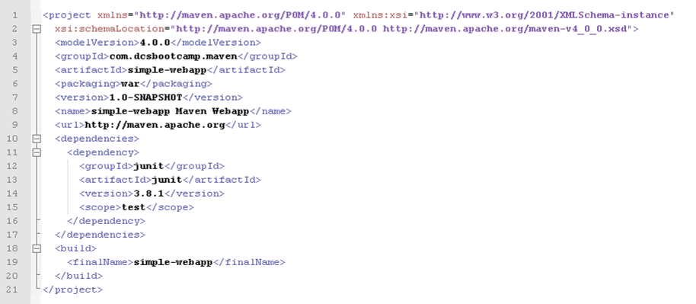
CREATING A NEW PROJECT
FROM AN ARCHETYPE
Check the pom.xml
MAVEN DEVOPS BOOTCAMP \ POM.XML
Notes:
BUILD - the process by which source code is converted into a stand-alone form that can be run on a computer or to the form itself. One of the most important steps of a software build is the compilation process, where source code files are converted into executable code.

Slide 37
CREATING A NEW PROJECT
FROM AN ARCHETYPE
Check the pom.xml
The archetype has substituted in the coordinates that it prompted for earlier.
It has also added the war packaging type to indicate that the build structure for the project is a web application.
MAVEN DEVOPS BOOTCAMP \ POM.XML
Notes:
BUILD - the process by which source code is converted into a stand-alone form that can be run on a computer or to the form itself. One of the most important steps of a software build is the compilation process, where source code files are converted into executable code.

Slide 38


CREATING A NEW PROJECT
FROM AN ARCHETYPE
The Maven coordinate of the project for reuse by other Maven projects
Project name, description and license
pom.xml
Project resource information
such as the location of source control, issue tracking, and continuous integration.
Developers, contributors and organizations participating in the project.
MAVEN DEVOPS BOOTCAMP \ POM.XML
Notes:
BUILD - the process by which source code is converted into a stand-alone form that can be run on a computer or to the form itself. One of the most important steps of a software build is the compilation process, where source code files are converted into executable code.

Slide 39
POM – PROJECT OBJECT MODEL
POM
POM Relationships
Build Settings
Coordinate
build
Coordinate
build
groupid
artifactid
version
groupid
artifactid
version
directories
The pom.xml file is the core of a project's configuration in Maven.
The POM is always in a file named pom.xml in the base directory of a Maven project.
It is a single configuration file that contains the majority of information required to build a project in just the way you want.
extensions
Multimodule
resources
Multimodule
Inheritance
plugins
Inheritance
Dependencies
reporting
Dependencies
reporting
General Project Info
Build Environment
General
Contributors
Licenses
General
Contributors
Licenses
Environment Info
Maven Environment
Profiles
MAVEN DEVOPS BOOTCAMP \ POM.XML
Notes:
The POM is huge and can be daunting in its complexity, but it is not necessary to understand all of the intricacies just yet to use it effectively.

Slide 40
POM QUICK OVERVIEW
<project xmlns="http://maven.apache.org/POM/4.0.0"
xmlns:xsi="http://www.w3.org/2001/XMLSchema-instance"
xsi:schemaLocation="http://maven.apache.org/POM/4.0.0
http://maven.apache.org/xsd/maven-4.0.0.xsd">
<modelVersion>4.0.0</modelVersion>
<!-- The Basics -->
<groupId>...</groupId>
<artifactId>...</artifactId>
<version>...</version>
<packaging>...</packaging>
<dependencies>...</dependencies>
<parent>...</parent>
<dependencyManagement>...</dependencyManagement>
<modules>...</modules>
<properties>...</properties>
This element indicates the unique identifier of the organization or group that created the project.
MAVEN DEVOPS BOOTCAMP \ POM.XML
Notes:
BUILD - the process by which source code is converted into a stand-alone form that can be run on a computer or to the form itself. One of the most important steps of a software build is the compilation process, where source code files are converted into executable code.

Slide 41
POM QUICK OVERVIEW
<project xmlns="http://maven.apache.org/POM/4.0.0"
xmlns:xsi="http://www.w3.org/2001/XMLSchema-instance"
xsi:schemaLocation="http://maven.apache.org/POM/4.0.0
http://maven.apache.org/xsd/maven-4.0.0.xsd">
<modelVersion>4.0.0</modelVersion>
<!-- The Basics -->
<groupId>...</groupId>
<artifactId>...</artifactId>
<version>...</version>
<packaging>...</packaging>
<dependencies>...</dependencies>
<parent>...</parent>
<dependencyManagement>...</dependencyManagement>
<modules>...</modules>
<properties>...</properties>
The groupId is one of the key identifiers of a project and is typically based on the fully qualified domain name of your organization. For example org.apache.maven.plugins is the designated groupId for all Maven plug-ins.
MAVEN DEVOPS BOOTCAMP \ POM.XML
Notes:
BUILD - the process by which source code is converted into a stand-alone form that can be run on a computer or to the form itself. One of the most important steps of a software build is the compilation process, where source code files are converted into executable code.

Slide 42
POM QUICK OVERVIEW
<project xmlns="http://maven.apache.org/POM/4.0.0"
xmlns:xsi="http://www.w3.org/2001/XMLSchema-instance"
xsi:schemaLocation="http://maven.apache.org/POM/4.0.0
http://maven.apache.org/xsd/maven-4.0.0.xsd">
<modelVersion>4.0.0</modelVersion>
<!-- The Basics -->
<groupId>...</groupId>
<artifactId>...</artifactId>
<version>...</version>
<packaging>...</packaging>
<dependencies>...</dependencies>
<parent>...</parent>
<dependencyManagement>...</dependencyManagement>
<modules>...</modules>
<properties>...</properties>
This element indicates the unique base name of the primary artifact being generated by
this project. The primary artifact for a project is typically a JAR file. Secondary artifacts
like source bundles also use the artifactId as part of their final name. A typical artifact
produced by Maven would have the form <artifactId>-<version>.<extension>
(for example, myapp-1.0.jar).
MAVEN DEVOPS BOOTCAMP \ POM.XML
Notes:
BUILD - the process by which source code is converted into a stand-alone form that can be run on a computer or to the form itself. One of the most important steps of a software build is the compilation process, where source code files are converted into executable code.

Slide 43
POM QUICK OVERVIEW
<project xmlns="http://maven.apache.org/POM/4.0.0"
xmlns:xsi="http://www.w3.org/2001/XMLSchema-instance"
xsi:schemaLocation="http://maven.apache.org/POM/4.0.0
http://maven.apache.org/xsd/maven-4.0.0.xsd">
<modelVersion>4.0.0</modelVersion>
<!-- The Basics -->
<groupId>...</groupId>
<artifactId>...</artifactId>
<version>...</version>
<packaging>...</packaging>
<dependencies>...</dependencies>
<parent>...</parent>
<dependencyManagement>...</dependencyManagement>
<modules>...</modules>
<properties>...</properties>
This element indicates the version of the artifact generated by the project
MAVEN DEVOPS BOOTCAMP \ POM.XML
Notes:
BUILD - the process by which source code is converted into a stand-alone form that can be run on a computer or to the form itself. One of the most important steps of a software build is the compilation process, where source code files are converted into executable code.

Slide 44
<!-- Build Settings -->
<build>...</build>
<reporting>...</reporting>
<!-- More Project Information -->
<name>...</name>
<description>...</description>
<url>...</url>
<inceptionYear>...</inceptionYear>
<licenses>...</licenses>
<organization>...</organization>
<developers>...</developers>
<contributors>...</contributors>
<!-- Environment Settings -->
<issueManagement>...</issueManagement>
<ciManagement>...</ciManagement>
<mailingLists>...</mailingLists>
<scm>...</scm>
<prerequisites>...</prerequisites>
<repositories>...</repositories>
<pluginRepositories>...</pluginRepositories>
<distributionManagement>...</distributionManagement>
<profiles>...</profiles>
</project>
POM
QUICK OVERVIEW
MAVEN DEVOPS BOOTCAMP \ BUILDING THE PROJECT
Notes:
BUILD - the process by which source code is converted into a stand-alone form that can be run on a computer or to the form itself. One of the most important steps of a software build is the compilation process, where source code files are converted into executable code.

Slide 45






BUILDING THE PROJECT
Build is run using a predefined, ordered set of steps (called PHASES) in a process called the BUILD LIFECYCLE.
validate
compile
test
package
install
deploy
MAVEN DEVOPS BOOTCAMP \ BUILDING THE PROJECT
Notes:
BUILD - the process by which source code is converted into a stand-alone form that can be run on a computer or to the form itself. One of the most important steps of a software build is the compilation process, where source code files are converted into executable code.

Slide 46
compile
test
package
install
deploy
validate
checks build prerequisites
MAVEN DEVOPS BOOTCAMP \ BUILDING THE PROJECT
Notes:
BUILD - the process by which source code is converted into a stand-alone form that can be run on a computer or to the form itself. One of the most important steps of a software build is the compilation process, where source code files are converted into executable code.

Slide 47
validate
test
package
install
deploy
compile
compiles the source code identified for the build
MAVEN DEVOPS BOOTCAMP \ BUILDING THE PROJECT
Notes:
BUILD - the process by which source code is converted into a stand-alone form that can be run on a computer or to the form itself. One of the most important steps of a software build is the compilation process, where source code files are converted into executable code.

Slide 48
validate
compile
package
install
deploy
test
runs unit tests for the compiled code
MAVEN DEVOPS BOOTCAMP \ BUILDING THE PROJECT
Notes:
BUILD - the process by which source code is converted into a stand-alone form that can be run on a computer or to the form itself. One of the most important steps of a software build is the compilation process, where source code files are converted into executable code.

Slide 49
validate
compile
test
install
deploy
package
assembles the compiled code into a binary build result
MAVEN DEVOPS BOOTCAMP \ BUILDING THE PROJECT
Notes:
BUILD - the process by which source code is converted into a stand-alone form that can be run on a computer or to the form itself. One of the most important steps of a software build is the compilation process, where source code files are converted into executable code.

Slide 50
validate
compile
test
package
deploy
install
Shares the build with other projects on the same machine
MAVEN DEVOPS BOOTCAMP \ BUILDING THE PROJECT
Notes:
BUILD - the process by which source code is converted into a stand-alone form that can be run on a computer or to the form itself. One of the most important steps of a software build is the compilation process, where source code files are converted into executable code.

Slide 51
validate
compile
test
package
install
deploy
publishes the build into a remote repository for other projects to use
MAVEN DEVOPS BOOTCAMP \ BUILDING THE PROJECT
Notes:
BUILD - the process by which source code is converted into a stand-alone form that can be run on a computer or to the form itself. One of the most important steps of a software build is the compilation process, where source code files are converted into executable code.

Slide 52
BUILDING THE PROJECT
The following is a complete list of phases available in Maven 2.2:
validate, generate-sources, process-sources, generate-resources,
process- resources, compile, process-classes, generate-test-sources,
process-test- sources, generate-test-resources, process-test-resources,
test-compile, test, prepare-package, package, integration-test, verify,
install, deploy
MAVEN DEVOPS BOOTCAMP \ CLEAN
Notes:
BUILD - the process by which source code is converted into a stand-alone form that can be run on a computer or to the form itself. One of the most important steps of a software build is the compilation process, where source code files are converted into executable code.

Slide 53

BUILDING THE PROJECT
In addition to the default build lifecycle we have seen before, it is worth noting that Maven has two other lifecycles built-in:
Clean
LIFECYCLE
The command mvn clean is often used to remove Maven's work directory target. However, as some plugins can generate information that does not reside in the work area, it is possible for them to bind to the clean lifecycle to clean up after themselves as well.
To help with ordering, the complete list of phases in the lifecycle is:
PRE-CLEAN
CLEAN
POST-CLEAN
MAVEN DEVOPS BOOTCAMP \ DEPLOY
Notes:
BUILD - the process by which source code is converted into a stand-alone form that can be run on a computer or to the form itself. One of the most important steps of a software build is the compilation process, where source code files are converted into executable code.

Slide 54

BUILDING THE PROJECT
SITE LIFECYCLE: While much of the site generation is coordinated by Maven's reporting mechanism, it is also possible to bind plugins to be executed as part of the site generation lifecycle. The phases available are pre-site, site, post-site, and site-deploy.
Site
LIFECYCLE
PRE-SITE
SITE
POST-SITE
SITE-DEPLOY
MAVEN DEVOPS BOOTCAMP \ BUILDING THE PROJECT
Notes:
BUILD - the process by which source code is converted into a stand-alone form that can be run on a computer or to the form itself. One of the most important steps of a software build is the compilation process, where source code files are converted into executable code.

Slide 55
BUILDING THE PROJECT
C:\myproject2\simple-webapp>mvn package
[INFO] Scanning for projects...
[INFO]
[INFO] ------------------------------------------------------------------------
[INFO] Building simple-webapp Maven Webapp 1.0-SNAPSHOT
[INFO] ------------------------------------------------------------------------
[INFO] --- maven-resources-plugin:2.4.3:resources (default-resources) @ simple-webapp ---
[INFO] Copying 0 resource
[INFO]
[INFO] --- maven-compiler-plugin:2.3.2:compile (default-compile) @ simple-webapp ---
[INFO] No sources to compile
[INFO]
[INFO] --- maven-resources-plugin:2.4.3:testResources (default-testResources) @simple-webapp ---
[INFO] No sources to compile
MAVEN DEVOPS BOOTCAMP \ HANDS ON EXERCISE
Notes:
BUILD - the process by which source code is converted into a stand-alone form that can be run on a computer or to the form itself. One of the most important steps of a software build is the compilation process, where source code files are converted into executable code.

Slide 56
BUILDING THE PROJECT
-------------------------------------------------------
T E S T S
-------------------------------------------------------
There are no tests to run.
Results :
Tests run: 0, Failures: 0, Errors: 0, Skipped: 0
[INFO]
[INFO] --- maven-war-plugin:2.1.1:war (default-war) @ simple-webapp ---
[INFO] Packaging webapp
[INFO] Assembling webapp [simple-webapp] in [C:\myproject2\simple-webapp\target\simple-webapp]
[INFO] Processing war project
[INFO] Copying webapp resources [C:\myproject2\simple-webapp\src\main\webapp]
[INFO] Webapp assembled in [125 msecs]
[INFO] Building war: C:\myproject2\simple-webapp\target\simple-webapp.war
[WARNING] Warning: selected war files include a WEB-INF/web.xml which will be ignored (webxml attribute is missing from war task, or ignoreWebxml attribute is specified as 'true')
[INFO] ------------------------------------------------------------------------
[INFO] BUILD SUCCESS
[INFO] ------------------------------------------------------------------------
[INFO] Total time: 8.157s
[INFO] Finished at: Fri Sep 09 09:21:43 GMT+08:00 2011
[INFO] Final Memory: 4M/15M
[INFO] ------------------------------------------------------------------------
MAVEN DEVOPS BOOTCAMP \ REUSING BUILDS
Notes:
BUILD - the process by which source code is converted into a stand-alone form that can be run on a computer or to the form itself. One of the most important steps of a software build is the compilation process, where source code files are converted into executable code.

Slide 57
REUSING BUILDS
Projects share their build products in the form of build artifacts, with the mechanism for sharing these artifacts being the Maven repositories.
Maven places artifacts to share with other builds that you run yourself from the same machine.
Note that the local repository is not intended for sharing among multiple users, however, when it comes to publishing a build for other developers or projects to use, a remote repository is used instead.
MAVEN DEVOPS BOOTCAMP \ HANDS ON EXERCISE
Notes:
BUILD - the process by which source code is converted into a stand-alone form that can be run on a computer or to the form itself. One of the most important steps of a software build is the compilation process, where source code files are converted into executable code.

Slide 58
C:\simple-webapp>mvn install
[INFO] Scanning for projects...
[INFO] ------------------------------------------------------------------------
[INFO] Building simple-webapp Maven Webapp
[INFO] task-segment: [install]
[INFO] ------------------------------------------------------------------------
[INFO] [resources:resources {execution: default-resources}][WARNING] Using platform encoding (Cp1252 actually) to copy filtered resources,i.e. build is platform dependent!
[INFO] Copying 0 resource
[INFO] [compiler:compile {execution: default-compile}]
[INFO] No sources to compile
[INFO] [resources:testResources {execution: default-testResources}]
[WARNING] Using platform encoding (Cp1252 actually) to copy filtered resources,
i.e. build is platform dependent!
[INFO] skip non existing resourceDirectory C:\simple-webapp\src\test\resources
[INFO] [compiler:testCompile {execution: default-testCompile}]
[INFO] No sources to compile
[INFO] [surefire:test {execution: default-test}]
[INFO] No tests to run.
[INFO] [war:war {execution: default-war}]
[INFO] Packaging webapp
[INFO] Assembling webapp[simple-webapp] in [C:\simple-webapp\target\simple-webapp]
[INFO] Processing war project
[INFO] Copying webapp resources[C:\simple-webapp\src\main\webapp]
[INFO] Webapp assembled in[31 msecs]
[INFO] Building war: C:\simple-webapp\target\simple-webapp.war
[INFO] [install:install {execution: default-install}]
[INFO] Installing C:\simple-webapp\target\simple-webapp.war to D:\Documents and Settings\john.alfred.s.blanch.MANILADC.001\.m2\repository\com\dcsbootcamp\maven\
simple-webapp\1.0-SNAPSHOT\simple-webapp-1.0-SNAPSHOT.war
[INFO] ------------------------------------------------------------------------
[INFO] BUILD SUCCESSFUL
[INFO] ------------------------------------------------------------------------
[INFO] Total time: 3 seconds
[INFO] Finished at: Fri Sep 16 16:57:48 CST 2011
[INFO] Final Memory: 9M/17M
[INFO] ------------------------------------------------------------------------
C:\simple-webapp>
As you can see, the web application has
been copied into the local repository.
This file is now available as a dependency
to other projects
MAVEN DEVOPS BOOTCAMP \ ADDING DEPENDENCIES
Notes:
BUILD - the process by which source code is converted into a stand-alone form that can be run on a computer or to the form itself. One of the most important steps of a software build is the compilation process, where source code files are converted into executable code.

Slide 59
ADDING DEPENDENCIES
A dependency is simply a way of expressing that the current project requires another project in order to build or run in some way, using the Maven coordinates to locate it.
another project you are building at the same time.
another project you have already built on the current machine (shared from the local repository).
a project built by another team member or a third party (downloaded from a remote repository).
MAVEN DEVOPS BOOTCAMP \ ADDING DEPENDENCIES
Notes:
BUILD - the process by which source code is converted into a stand-alone form that can be run on a computer or to the form itself. One of the most important steps of a software build is the compilation process, where source code files are converted into executable code.

Slide 60
ADDING DEPENDENCIES
create a source file called :
src/main/java/com/dcsbootcamp/maven/ExampleAction.java
package com.dcsbootcamp.maven;
import org.slf4j.*;
public class ExampleAction {
final Logger logger =
LoggerFactory.getLogger(ExampleAction.class);
public boolean execute() {
logger.info( "Example action executed" );
return true;
}
}
Note that the third party library SLF4J (http://slf4j.org) is used.
MAVEN DEVOPS BOOTCAMP \ ADDING DEPENDENCIES
Notes:
BUILD - the process by which source code is converted into a stand-alone form that can be run on a computer or to the form itself. One of the most important steps of a software build is the compilation process, where source code files are converted into executable code.

Slide 61
C:\simple-webapp>mvn compile
[INFO] Scanning for projects...
[INFO] ------------------------------------------------------------------------
[INFO] Building simple-webapp Maven Webapp
[INFO] task-segment: [compile]
[INFO] ------------------------------------------------------------------------
[INFO] [resources:resources {execution: default-resources}]
[WARNING] Using platform encoding (Cp1252 actually) to copy filtered resources,
i.e. build is platform dependent!
[INFO] Copying 0 resource
[INFO] [compiler:compile {execution: default-compile}]
[INFO] Compiling 1 source file to C:\simple-webapp\target\classes
[INFO] ------------------------------------------------------------------------
[ERROR] BUILD FAILURE
[INFO] ------------------------------------------------------------------------
[INFO] Compilation failure
Maven makes including this very easy,
by adding the dependency to the
project file pom.xml:
MAVEN DEVOPS BOOTCAMP \ ADDING DEPENDENCIES
Notes:
BUILD - the process by which source code is converted into a stand-alone form that can be run on a computer or to the form itself. One of the most important steps of a software build is the compilation process, where source code files are converted into executable code.

Slide 62
[INFO] Compilation failure
C:\simple-webapp\src\main\java\com\dcsbootcamp\maven\ExampleAction.java:[2,0] package org.slf4j does not exist
C:\simple-webapp\src\main\java\com\dcsbootcamp\maven\ExampleAction.java:[5,14]
cannot find symbol
symbol : class Logger
location: class com.dcsbootcamp.maven.ExampleAction
C:\simple-webapp\src\main\java\com\dcsbootcamp\maven\ExampleAction.java:[6,12] cannot find symbol
symbol : variable LoggerFactory
location: class com.dcsbootcamp.maven.ExampleAction
[INFO] ------------------------------------------------------------------------
[INFO] For more information, run Maven with the -e switch
[INFO] ------------------------------------------------------------------------
[INFO] Total time: 4 seconds
[INFO] Finished at: Fri Sep 16 17:52:12 CST 2011
[INFO] Final Memory: 8M/14M
[INFO] ------------------------------------------------------------------------
C:\simple-webapp>
Maven makes including this very easy,
by adding the dependency to the
project file pom.xml:
MAVEN DEVOPS BOOTCAMP \ ADDING DEPENDENCIES
Notes:
BUILD - the process by which source code is converted into a stand-alone form that can be run on a computer or to the form itself. One of the most important steps of a software build is the compilation process, where source code files are converted into executable code.

Slide 63
ADDING DEPENDENCIES
[...]
<dependencies>
[...]
<dependency>
<groupId>org.slf4j</groupId>
<artifactId>slf4j-api</artifactId>
<version>1.5.0</version>
</dependency>
</dependencies>
MAVEN DEVOPS BOOTCAMP \ HANDS ON EXERCISE
Notes:
BUILD - the process by which source code is converted into a stand-alone form that can be run on a computer or to the form itself. One of the most important steps of a software build is the compilation process, where source code files are converted into executable code.

Slide 64
C:\simple-webapp>mvn compile
[INFO] Scanning for projects...
[INFO] ------------------------------------------------------------------------
[INFO] Building simple-webapp Maven Webapp
[INFO] task-segment: [compile]
[INFO] ------------------------------------------------------------------------
[INFO] [resources:resources {execution: default-resources}]
[WARNING] Using platform encoding (Cp1252 actually) to copy filtered resources,
i.e. build is platform dependent!
[INFO] Copying 0 resource
Downloading: http://repo1.maven.org/maven2/org/slf4j/slf4j-api/1.5.0/slf4j-api-1
.5.0.pom
Downloading: http://repo1.maven.org/maven2/org/slf4j/slf4j-parent/1.5.0/slf4j-pa
rent-1.5.0.pom
Downloading: http://repo1.maven.org/maven2/org/slf4j/slf4j-api/1.5.0/slf4j-api-1
.5.0.jar
[INFO] [compiler:compile {execution: default-compile}]
[INFO] Compiling 1 source file to C:\simple-webapp\target\classes
[INFO] ------------------------------------------------------------------------
[INFO] BUILD SUCCESSFUL
[INFO] ------------------------------------------------------------------------
[INFO] Total time: 6 seconds
[INFO] Finished at: Fri Sep 16 18:02:55 CST 2011
[INFO] Final Memory: 8M/14M
[INFO] ------------------------------------------------------------------------
C:\simple-webapp>
MAVEN DEVOPS BOOTCAMP \ BUILDING A PROJECT SITE
Notes:
BUILD - the process by which source code is converted into a stand-alone form that can be run on a computer or to the form itself. One of the most important steps of a software build is the compilation process, where source code files are converted into executable code.

Slide 65
BUILDING A PROJECT SITE
Maven can be used to create a project web site to capture information which is relevant to both the end-user and the developer audience.
Out of the box, Maven can generate reports on everything from unit test failures to package coupling to reports on code quality.
Maven provides you with the ability to write simple web pages and render those pages against a consistent project template.
Maven can publish site content in multiple formats including XHTML and PDF
Once you’ve used Maven to generate all of your project’s end-user and developer documentation, you can then use Maven to publish your web site to a remote server.
MAVEN DEVOPS BOOTCAMP \ BUILDING A PROJECT SITE
Notes:
BUILD - the process by which source code is converted into a stand-alone form that can be run on a computer or to the form itself. One of the most important steps of a software build is the compilation process, where source code files are converted into executable code.

Slide 66
BUILDING A PROJECT SITE
1
2
3
Run the following command:
mvn archetype:generate -DgroupId=org.sonatype.mavenbook -DartifactId=sample-project
This creates the simplest possible Maven project with one Java class in src/main/java and a simple POM.
mvn site:run
Once Jetty starts and is listening to port 8080, you can see the project’s site when you go to http://localhost:8080/ in a web browser
Note: To customize the site, you’ll have to start to add content to the project and to the project’s POM.
MAVEN DEVOPS BOOTCAMP \ BUILDING A PROJECT SITE
Notes:
This creates the simplest possible Maven project with one Java class in src/main/java and a simple POM. You can then build a
Maven site by simply running mvn site. To build the site and preview the result in a browser, you can run mvn site:run, this
will build the site and start an embedded instance of Jetty.

Slide 67
BUILDING A PROJECT SITE
CUSTOMIZE SITE DESCRIPTOR
When you add content to the site, you are going to want to modify the left-hand navigation menu that is generated with your site.
The following site descriptor customizes the logo in the upper left-hand corner of the site.
In addition to customizing the header of the site, this descriptor adds a menu section to the left-hand navigation menu under the heading "Sample Project".
This menu contains a single link to an overview page
Create site.xml under <basedir>/src/site
MAVEN DEVOPS BOOTCAMP \ BUILDING A PROJECT SITE
Notes:
BUILD - the process by which source code is converted into a stand-alone form that can be run on a computer or to the form itself. One of the most important steps of a software build is the compilation process, where source code files are converted into executable code.

Slide 68
BUILDING A PROJECT SITE
CUSTOMIZE SITE DESCRIPTOR
<project name="Sample Project">
<bannerLeft>
<name>Sonatype</name>
<src>images/logo.png</src>
<href>http://www.accenture.com</href>
</bannerLeft>
<body>
<menu name="Sample Project">
<item name="Overview" href="index.html"/>
</menu> <menu ref="reports"/>
</body>
</project>
This logo.png image should be placed in ${basedir}/src/site/resources/images. In addition to the change to the site descriptor, you’ll want to create a simple index.apt page in ${basedir}/src/site/apt. Put the following content in index.apt, it will be transformed to the index.html and serve as the first page a user sees when they come to your project’s Maven-generated web site
MAVEN DEVOPS BOOTCAMP \ BUILDING A PROJECT SITE
Notes:
BUILD - the process by which source code is converted into a stand-alone form that can be run on a computer or to the form itself. One of the most important steps of a software build is the compilation process, where source code files are converted into executable code.

Slide 69
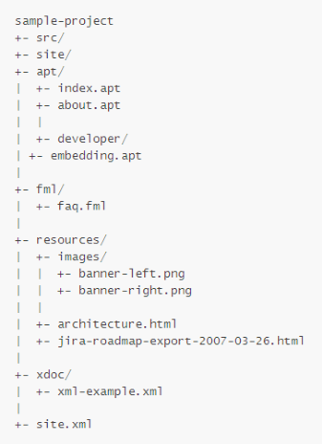
BUILDING A PROJECT SITE
CUSTOMIZE SITE DESCRIPTOR
To run:
mvn clean site
mvn site:run
Site directory structure
MAVEN DEVOPS BOOTCAMP \ BUILDING A PROJECT SITE
Notes:
BUILD - the process by which source code is converted into a stand-alone form that can be run on a computer or to the form itself. One of the most important steps of a software build is the compilation process, where source code files are converted into executable code.

Slide 70
BUILDING A PROJECT SITE
CUSTOMIZE SITE DESCRIPTOR
To be able to deploy the site, you must first declare a location to distribute to in your pom.xml, similar to the repository for deployment.
<project>
...
<distributionManagement>
<site>
<id>sample-project.website</id>
<url>scp://www.mycompany.com/www/docs/project/</url>
</site>
</distributionManagement>
...
</project>
Deploying the site is done by using the site-deploy phase of the site lifecycle:
mvn site-deploy
MAVEN DEVOPS BOOTCAMP \ REFERENCES
Notes:
BUILD - the process by which source code is converted into a stand-alone form that can be run on a computer or to the form itself. One of the most important steps of a software build is the compilation process, where source code files are converted into executable code.

Slide 71
CUSTOMIZE SITE DESCRIPTOR
REFERENCES
To be able to deploy the site, you must first declare a location to distribute to in your pom.xml, similar to the repository for deployment.
<project>
...
<distributionManagement>
<site>
<id>sample-project.website</id>
<url>scp://www.mycompany.com/www/docs/project/</url>
</site>
</distributionManagement>
...
</project>
Deploying the site is done by using the site-deploy phase of the site lifecycle:
mvn site-deploy
http://www.sonatype.com/books/mvnref-book/reference
http://maven.apache.org/
MAVEN DEVOPS BOOTCAMP \ HANDS ON EXERCISE
Notes:
BUILD - the process by which source code is converted into a stand-alone form that can be run on a computer or to the form itself. One of the most important steps of a software build is the compilation process, where source code files are converted into executable code.

